Slide 1
STUDY OF CURRENT AND PROPOSED PREFETCH ALGORITHMS
SAPTHAGIRI VENKAT RAGHURAMAN
SAI VYSHNAVE KODURU SRINIVASA
SOURAV RANJAN

Slide 2
AGENDA
PREFETCHING
1. REFERENCE PREDICTION TABLE
2. DELTA CORRELATION TABLE
3. DIFFERENTIAL FINITE CONTEXT METHOD PREFETCHER
METHODOLOGIES
RESULTS & ANALYSIS
IMPLEMENTATION DETAILS

Slide 3
PREFETCHING
As processors have greatly increased in speed over time, improvements to memory access speeds have been less significant.
This creates a situation in which the processor is frequently waiting long periods of time for the memory system to provide it some data.
Caches are a powerful and commonplace strategy for mitigating this inefficiency, but cache misses still constitute one of the major hindrances on processor performance.
One technique for further reducing memory stalls is to prefetch data that will be needed soon into the cache.

Slide 4
PREFETCHING
While prefetching is potentially powerful, it must be employed carefully because prefetching data which already resides in the cache or which is not actually needed will degrade performance.
With systems using cache we see if there is a cache miss it imposes a severe penalty on the performance of processor as there are not enough instructions for the processor to execute.
To avoid this situation, processors use prefetching to reduce cache misses which is of two types: instruction prefetch and data prefetch.

Slide 5
REFERENCE PREDICTION TABLE
Reference Prediction Table (RPT), is a strided-prefetcher, proposed by Tien-Fu Chen and Jean-Loup Baer.
RPT is a large table, where each entry is indexed by the program counter (PC).
It further stores the last address and the delta. During the initialization of the prefetcher, an empty table is created.
Upon a cache miss, the table is accessed to ﬁnd an entry indexing the current program counter. If there is no existing entry, a new entry is created.
If an entry with the current program counter is found, the last effective address which is stored in the entry is used to calculate a new delta.

Slide 6
REFERENCE PREDICTION TABLE
A new prefetch is only issued if the delta of the current address and the last address are equivalent to the delta which is stored in the entry.
Using the standard RPT prefetch algorithm, only one single prefetch is issued at the same time.
This means that predicting a cache block can only be done one iteration in advance.
To improve the prefetching performance, there are several other approaches like eXtended RPT prefetch (XRPTP), where two prefetches are issued at the same time.
Also for each entry in the table, only one single delta is stored.

Slide 7
DELTA CORRELATION TABLE
The Delta-Correlating Prediction Table (DCPT) approach is inspired by the RPT prefetching scheme.
Like RPT, a large table is used to store the entries indexed by the program counter.
The prefetching stage begins when the PC is used to lookup the corresponding entry in the table.
If an entry is not found, a new entry indexing to the current PC is created.
At the same time, the last address is set to the current cache line miss address.
After that, the delta between the current address and the last address is calculated.

Slide 8
DELTA CORRELATION TABLE
Only if the new delta is non-zero, the circular buffer with deltas is updated with the new delta. The delta values that are zero are ignored.
Delta-Correlation begins after the entry is updated, where a backwards matching search is performed to ﬁnd a striding pattern.
The most recent pair of deltas are being compared to ﬁnd a match.
If a match is detected, all deltas after the match are added to a temporary prefetching candidate buffer.
After the deltas are added to the prefetching candidates buffer, the candidates are compared with the content of the cache, Miss Status Holding Registers (MSHR) and a pending buffer queue that holds other prefetching requests that are not ﬁnished.
If the address of a candidate is matching with an address in any of the these locations, the candidate is removed from the buffer. A prefetching request is issued for the candidates that are still in the buffer.

Slide 9
DIFFERENCIAL FINITE CONTEXT METHOD PREFETCHER
The PDFCM (Differencial Finite Context Method Prefetcher) is a markovian prefetching technique.
PDFCM stores values and the differences between them (deltas). For example, for a pattern 1, 2, 3, 6, PDFCM stores the deltas 1, 1 and 3 and the last value 6. In our scheme, patterns are consecutive memory load requests.
Inspired by Ramos et al., we only use addresses that result in cache misses as training sequences. Unlike their work, we do not combine PDFCM with a stride prefetcher.
Also, we do not include a hit counter in our tables. This variable is used to count how many successful prefetches are made for a given prediction. The intention is to increase prefetching accuracy, only allowing a prefetch when the hit counter passes a threshold.
The reason for the exclusion of this variable is to reduce memory usage.

Slide 10
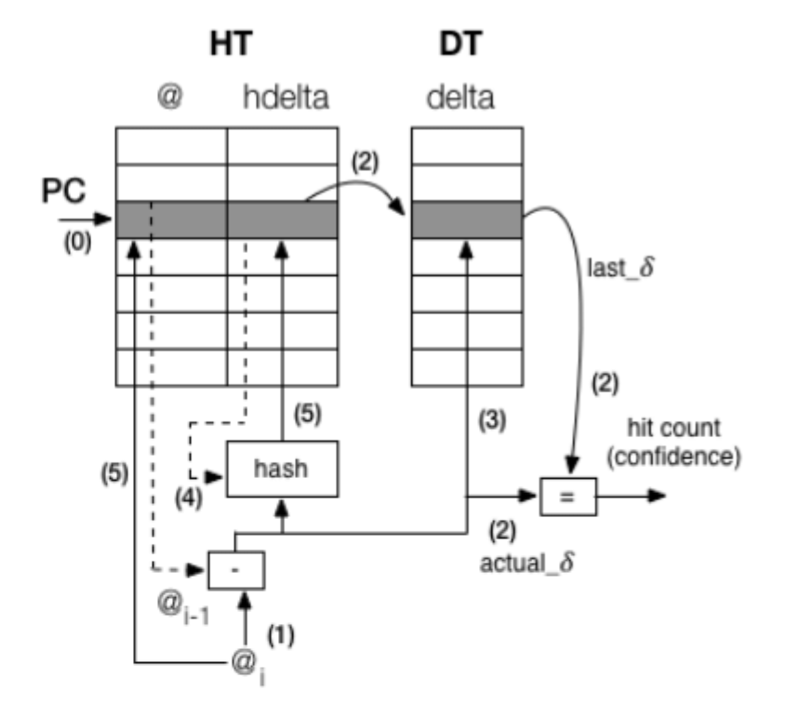
DIFFERENCIAL FINITE CONTEXT METHOD PREFETCHER

Slide 11
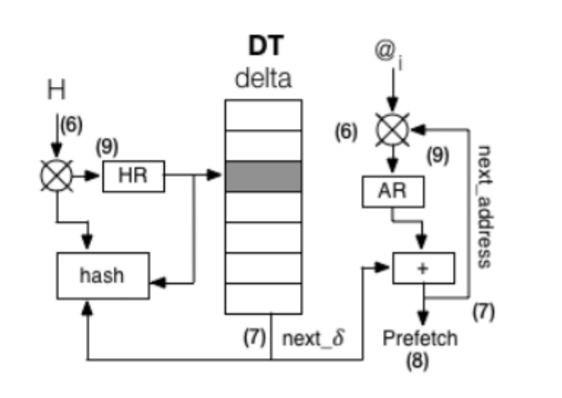
DIFFERENCIAL FINITE CONTEXT METHOD PREFETCHER

Slide 12
Methodology
SPEC 2017
Benchmarks are:
ammp-computational chemistry
applu – Elliptic partial differential equations.
apsi – Meterology pollutant distribution
art- image recognition/neural networks
Bzip2_graphic –graphic compression
Bzip2_program- program compression
bZip2_source- source compression
Galgel- Computational Fluid Dynamics
Swim - Shallow Water Modeling
Twolf- computer aided design
Wupwise-Physics / Quantum Chromodynamics

Slide 13
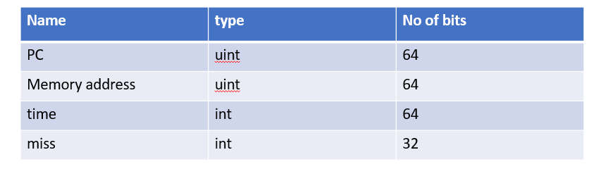
We implemented handlers for two events in the M5 frame-work.
prefetch complete() - triggered when prefetched memory arrives in the L2 cache.
prefetch access() , triggered at the beginning of each CPU cycle.
With each processed event we receive a snapshot of the system state: program counter, cycle counter and current memory address being requested.
We also use the GEM5 API to check the MSHR and cache for addresses.

Slide 14
Speed up
Speedup = IPCwith prefetch / IPCwithout prefetch
If the speed up is larger than 1
- Program issued more instructions without prefetchers.
- i.e more computation is done.
The speed up is deceptive.

Slide 15
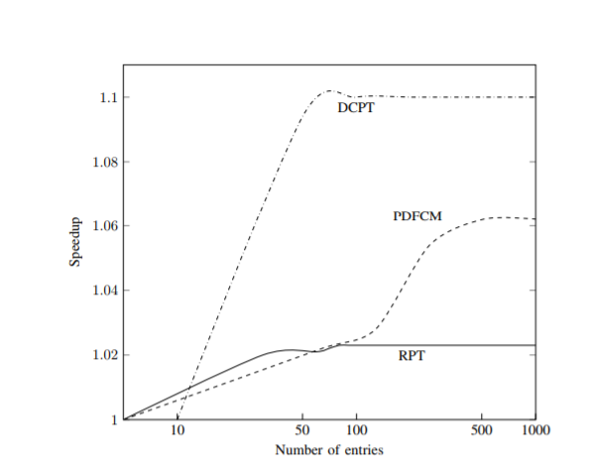
RESULTS
For PDFCM, the amount of entries in the DT and HT should be close in powers of two to avoid memory aliasing.
More entries in the table should increase accuracy.
To maximize the amount of entries possible for
16-, 32- and 64-bit variables for an L2 cache with 8KB of memory,
we can have 1024 entries in each table for 16 bits, 512 with 32 bits, and 256 with 64 bits.
We find that the best score is when using a 32 bit configuration. This indicates that using 64 bits in each entry introduces memory aliasing due to loss of information when hashing deltas.
Fig : difference in speedup depending on the number of entries.

Slide 16
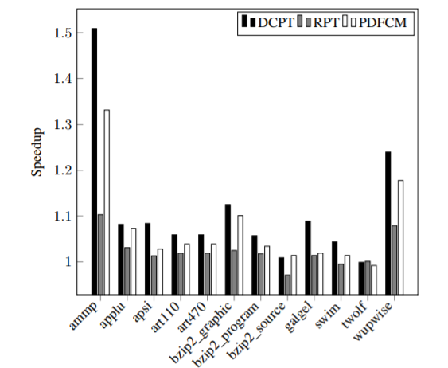
DCPT clearly has better speedup when compared to the other schemes, with up to 51% speedup.
DCPT outperforms RPT mainly due to:
RPT not being able to detect the same access patterns as DCPT, because DCPT holds a history of several deltas while RPT only holds the last calculated delta.
Also RPT is more conservative with respect to issuing prefetches compared to DCPT.
PDFCM also has less coverage and accuracy than DCPT, assumably because of small table sizes and loss of accuracy in the hashing function.
Fig: Speedup for each benchmark test relative to no prefetching

Slide 17
coverage
Program avoids accessing memory,IPC count will begin
-leads to spinlock .
High coverage: prefetcher predicts most of the memory access issued
Low coverage – if no prefetcher was made.
A high speed up with low coverage
- good results achieved by prefetcher .
Coverage = Number of useful prefetches/ Number of cache misses without prefetch

Slide 18
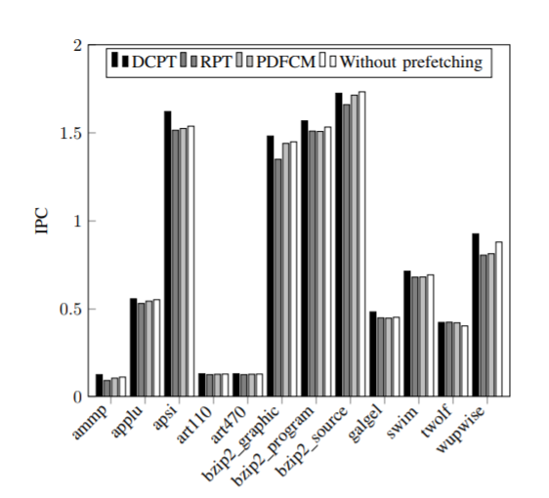
Comparisons of the IPC between the implemented prefetching schemes and the IPC without prefetching.
The figure shows that the IPC of all three schemes are improved in almost each benchmark.
Since the speedup is calculated using the IPC without prefetch, described using Equation , the improvement of IPC is reflected upon in Fig.
IPC for each benchmark test

Slide 19
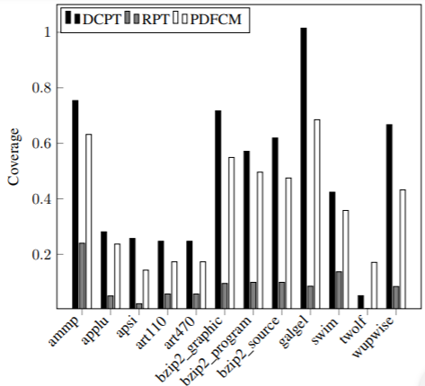
Coverage for each benchmark test. DCPT outperforms the coverage for both the other methods

Slide 20
Accuracy
High accuracy – prefetcher data are not needed by the app
or
data is not fetched at right time.
Low accuracy – cache pollution
prefetched data will be replaced by more useful data .
Accuracy = Amount of useful prefetches / Amount of prefetches

Slide 21
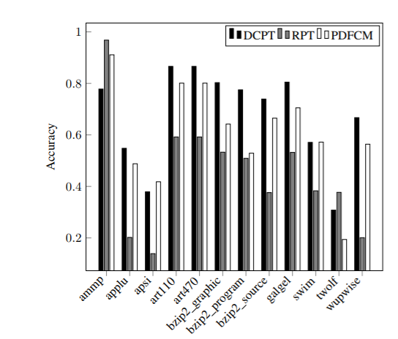
We can see that test results for RPT are affected by cache pollution and bad timeliness.
when RPT does not detect the access pattern, there is a reduction in coverage and accuracy.
cache miss increase which will make the load instruction take longer time to fetch the required data from the main memory.
Thus the average amount of instructions executed per cycle will decrease.
Accuracy for each benchmark test.

Slide 22
Implementation of Prefetcher based on Modified Markov Predictor

Slide 23
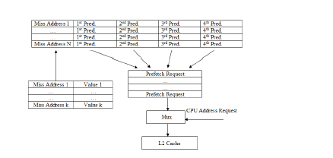
Modifying Markov Predictor with Stride Prefetcher and Pointer Reference Detection

Slide 24
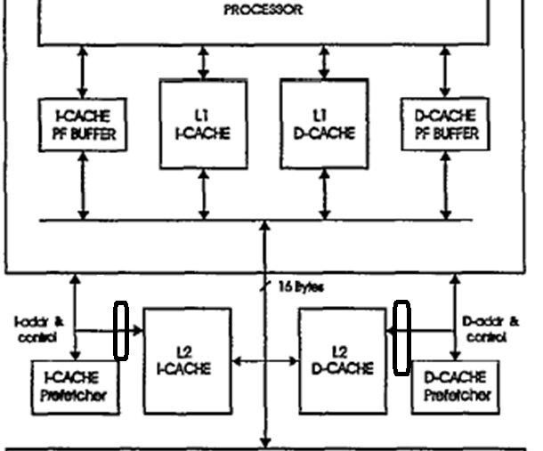
Adding Stride Prefetcher between L2 and Markov Prefetcher
We are going to add a Stride Prefetcher between L2 cache and I-Cache and D-cache Prefetcher.
Since Markov Predictor is bad at finding strides adding a stride prefetcher will improve it accuracy.

Slide 25
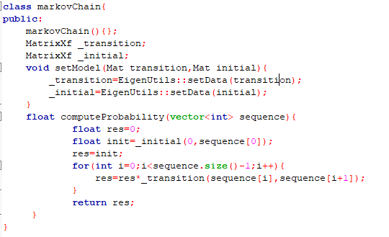
C++ code for Markov chain
Class for Markov chain:
A markov chain is composed of transition matrix and initial probability matrix

Slide 26
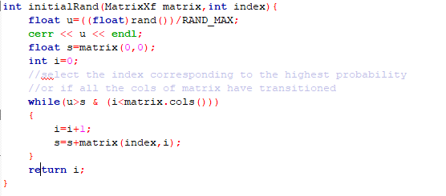
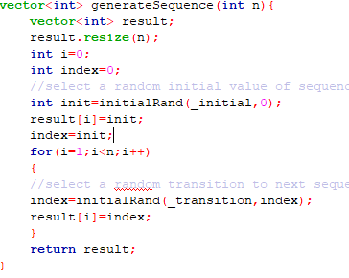
Code continued…..
Random number generator
Sequence Generator for Markov chain

Slide 27
Work Still need to Be Done on Modified Markov Predictor
Figuring out how to pass L1 misses to Markov Sequence generator in gem5
Implementing the stride hardware on top of the Markov Predictor

Slide 28
Implementation Details

Slide 29
Gem5 Performance evaluation details
With the gem5 Simulator using
– x86 CPUs
– L1 prefetchers
– Ruby memory system
– MOESI coherency protocol
– Garnet network simulator

Slide 30
Implementation contd.
OS: Ubuntu 18.1 on Google Compute Engine
Gem5 configurations:
mode: Syscall Emulation(SE) mode
ISA : X86 architecture
Memory Systems: Classic and Ruby
Replacement Policy: LRU
Network Topology: Crossbar
Benchmark: Spec 2017 (leela, x264, gcc)

Slide 31
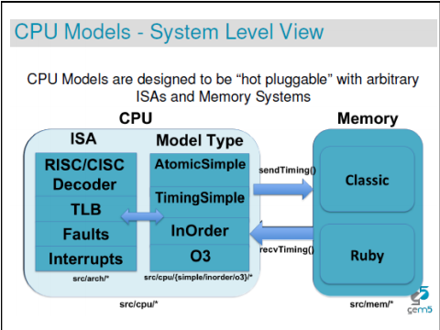
gem5 memory model

Slide 32
Ruby Model:
./configs/example/se.py
Configures the gem5 simulator as per the settings in the script
./configs/example/Spec_cpu2017.py
Configuration setting on how my benchmark is going to run on gem5
Command to run:
./build/X86/gem5.opt configs/example/se.py --benchmark=leela --ruby --caches --maxinsts=100000 --l1d_size=64kB --l1i_size=64kB --mem-size=512MB --cacheline_size=64

Slide 33
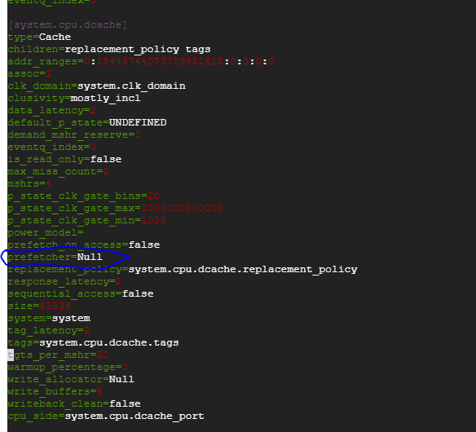
Config.ini
Contains a list of every SimObject created for the simulation and the values for its parameters
Location - /gem5/m5out

Slide 34
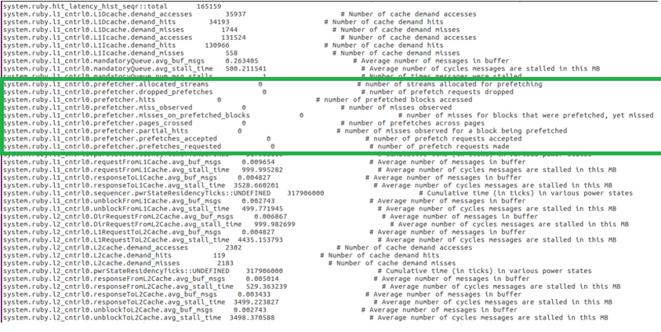
Output in Stats.txt in /gem5/m5out

Slide 35
Reference
[1]. http://web.engr.oregonstate.edu/~benl/Projects/prefetch_report/final.html [2]. Doug Joseph, Dirk Grnnwald , “Prefetching using Markov Predictors ”.
[3].https://www.researchgate.net/publication/328597173_Final_Report_Implementing_and_Testing_Four_Prefetching_Cache_Algorithms
[4] http://www.gem5.org/General_Memory_System
[5] http://learning.gem5.org/book/index.html
[6] Ben weber, “Data Prefetching using a modified Markov Predictor ”, “https://pdfs.semanticscholar.org/f135/7c9eb32fcb9858739c46c173ecfb639a69fb.pdf”
[7] Thomas Rosen; Wee-Shong Ong; Jason Upton, “ECE570 Final Paper” “http://web.engr.oregonstate.edu/~benl/Projects/prefetch_report/final.html”

